Slide 1

CONTENTS
Abstract
Hardware Used
Block Diagram
Sensor Placement and Design
Working
Applications
Advantages & Disadvantages
Future Trends
Conclusion

Slide 2
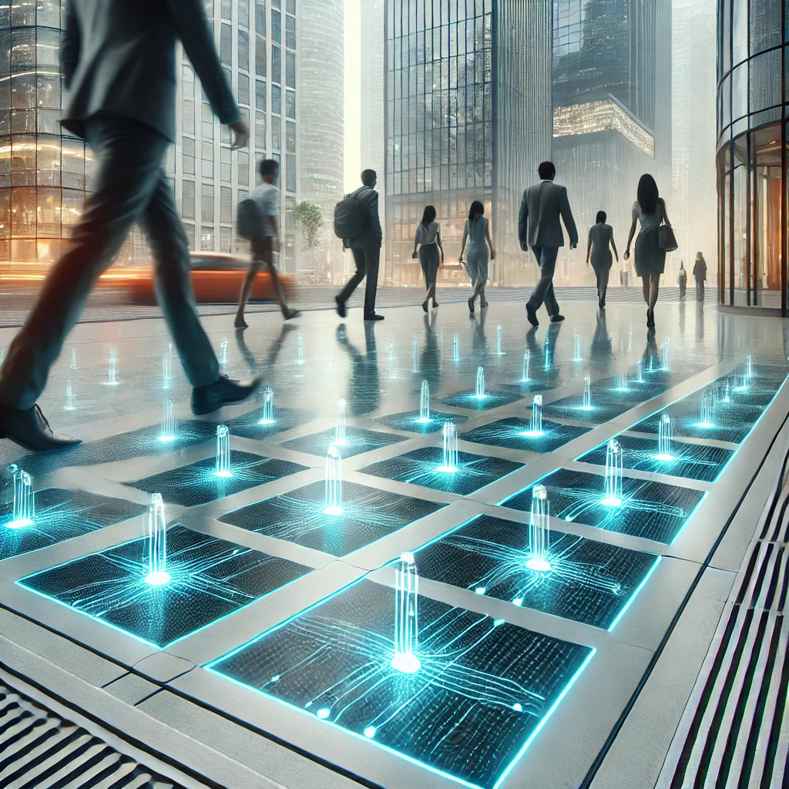
Abstract
In today’s world, we need more clean and renewable energy. One smart way to create electricity is by using piezoelectric sensors to generate power from footsteps.
This project works by placing special sensors under floors or walkways. When people walk on them, the sensors convert pressure into electricity. This energy can be stored in batteries or used to power small devices like street lights and mobile chargers.
This idea is useful in busy places like train stations, malls, and parks. It helps save energy, reduces pollution, and provides a simple way to create electricity from walking.

Slide 3

Block Diagram
FOOT STEP
Piezoelectric Sensor
Rectifier
Load
(Light)
Relay
Battery

Slide 4
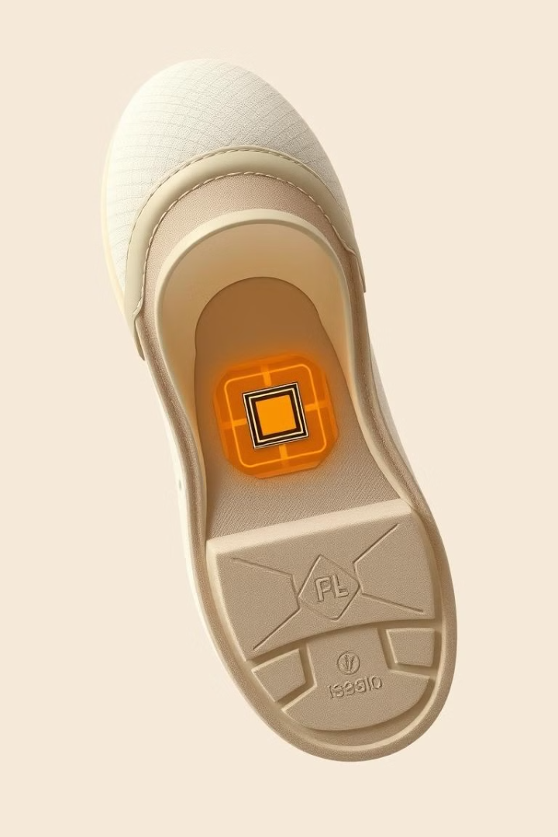
Piezoelectric Sensor Placement and Design
Shoe Soles
Floor Tiles
Sensors can be integrated into the soles of shoes, harnessing the pressure from each step.
Piezoelectric tiles embedded in floors can generate power from footsteps in high-traffic areas.
Walkways and Paths
Design Considerations
Sensor strips can be installed in walkways and paths, capturing energy from pedestrians.
Factors like sensor size, material type, and placement impact energy efficiency.

Slide 5
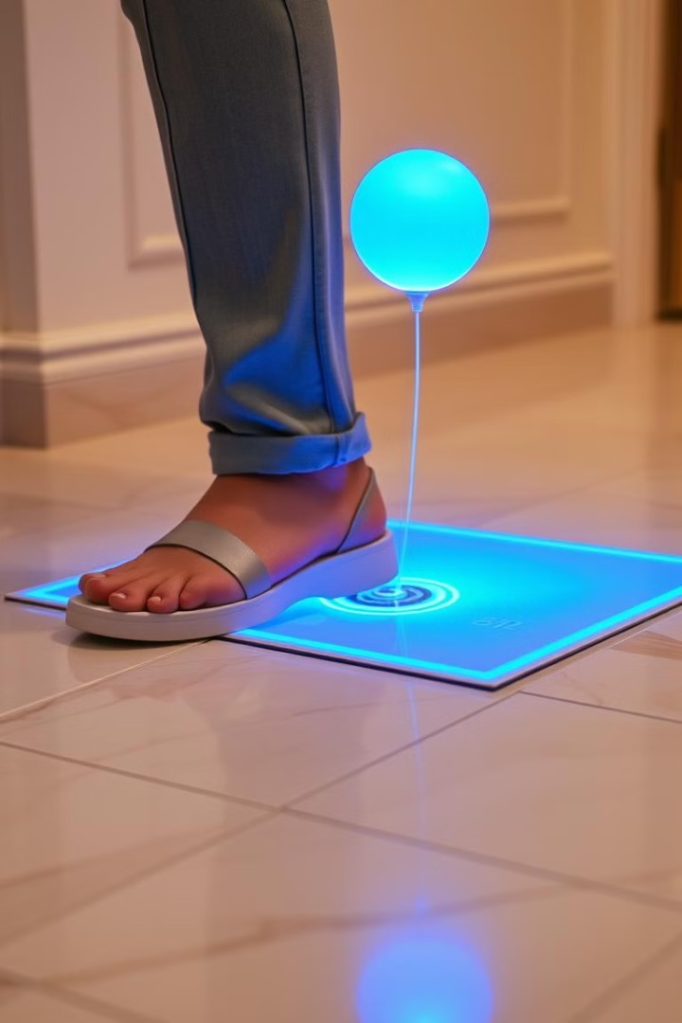
Working
1
Step 1: Pressure
As a person walks, their foot applies pressure to the piezoelectric sensor.
2
Step 2: Charge Generation
The sensor converts the pressure into an electric charge, creating a voltage.
3
Step 3: Energy Storage
The generated voltage is stored in a capacitor or battery for later use.
4
Step 4: Power Output
The stored energy can power low-power devices or be used for various applications.

Slide 6





Applications
Public Lighting
Wearable Electronics
Foot step power can be used to illuminate public areas, reducing dependence on traditional power grids.
Piezoelectric sensors in shoes can power wearable devices, such as fitness trackers and smartwatches.
Home Energy
Building Infrastructure
Foot step power can contribute to the energy needs of homes, making them more self-sufficient.
Sensors in high-traffic areas can power building systems, reducing energy consumption.

Slide 7






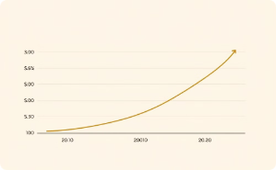
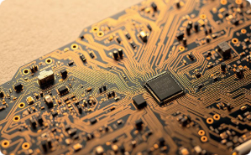
Advantages and Limitations
Advantages
Limitations
Sustainable and Renewable: Foot step power is a clean and renewable energy source.
Zero Emissions: It does not produce greenhouse gases, contributing to a greener environment.
Low Power Output: The amount of energy generated from each step is relatively low.
Efficiency Challenges: The conversion process can be inefficient, requiring further optimization.
Versatile Application: It can be implemented in various settings, from sidewalks to wearable devices.
Improved Infrastructure: Can power public areas without additional grid loads, improving city infrastructure.
Cost Considerations: Implementing large-scale foot step power systems can be expensive.
Technological Complexity: The technology is currently complex and may require specialized knowledge for maintenance.

Slide 8




Future Trends
Enhanced Material Development
1
New materials with improved piezoelectric properties are being researched.
Improved Energy Conversion
2
More efficient energy conversion technologies are being developed.
Integration with Smart Cities
3
Foot step power is expected to play a role in smart city initiatives.
Wireless Power Transmission
4
Research on wireless power transmission from foot step energy is underway.

Slide 9
Conclusion
The Footstep Power Generation Using Piezoelectric Sensors project demonstrates an innovative way to produce electricity from human footsteps. By using piezoelectric sensors, mechanical energy from walking is converted into electrical energy, which can be stored or used for small applications like lighting and charging devices.
This technology is eco-friendly, cost-effective, and sustainable, making it ideal for use in crowded areas such as shopping malls, railway stations, and parks. While the energy output from a single step is small, combining multiple sensors over a large area can generate a significant amount of power.
In the future, advancements in piezoelectric materials and energy storage can further improve efficiency, making this a practical solution for smart cities and renewable energy development. This project serves as a stepping stone toward harnessing human movement for clean energy generation.

Slide 10

THANK YOU !!
“ANY QUERIES !”

